Slide 1
Capstone project - The Battle of Neighbourhoods
Prague Start-up searching for location of their new office

Slide 2
Introduction
A Prague Start-up is searching for a new location for their offices
Their current office is in Prague 6
They have a specific corporate culture and thus want to attract young people who share the same mind-set
The founders believe that the location of the offices plays a key role in attracting new employees

Slide 3
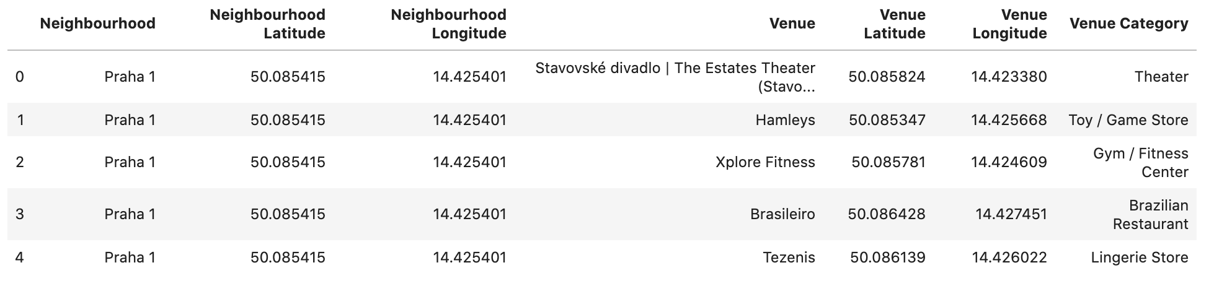
Data
Foursquare API (venue categories, etc.)
Prague neighbourhood ZIP codes

Slide 4
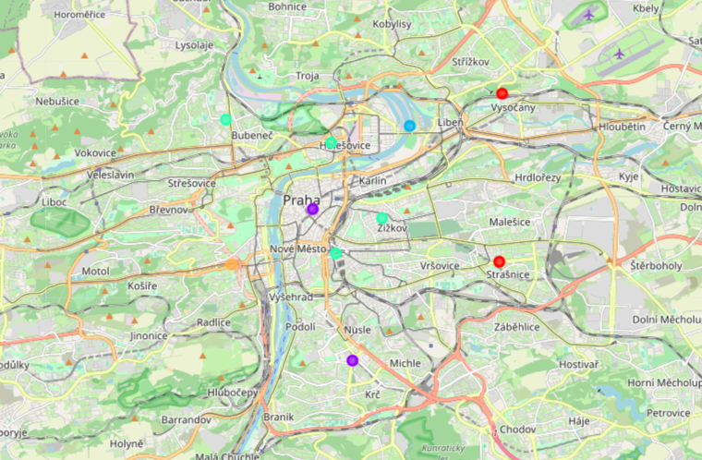
Methodology
ML technique - K-means clustering

Slide 5
Results
Cluster 0: Prague 10, Prague 9
Cluster 1: Prague 1, Prague 4
Cluster 2: Prague 8
Cluster 3: Prague 2, Prague 3, Prague 6, Prague 7
Cluster 4: Prague 5

Slide 6
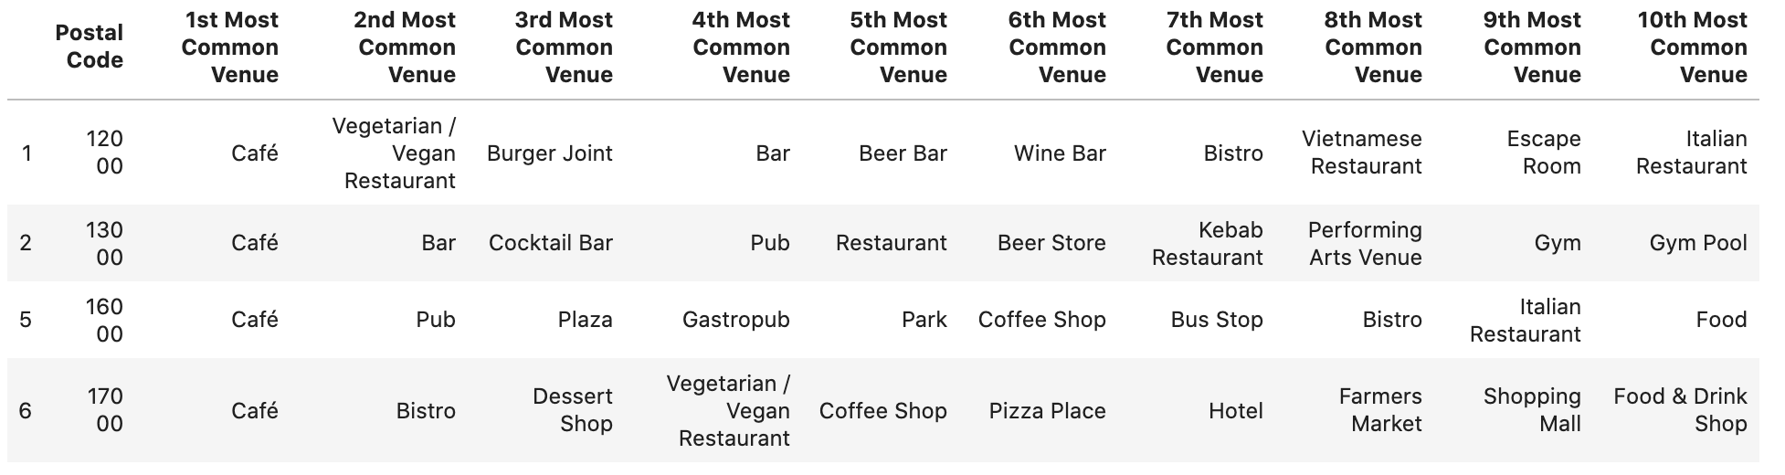
Conclusion
Recommendation to move to Prague 2, Prague 3 or Prague 7
They are the most similar to Prague 6 - company's current location

